Slide 1
Introduction to Sharding
#MongoDBDays
Craig Wilson
Software Engineer, MongoDB
@craiggwilson

Slide 2
Sharding is a
Solution for scalability

Slide 3
Examining Growth
User Growth
1995: 0.4% of the world’s population
Today: 30% of the world is online (~2.2B)
Emerging Markets & Mobile
Data Set Growth
Facebook’s data set is around 100 petabytes
4 billion photos taken in the last year (4x a decade ago)
Notes:
The goal here is to talk about data growth in general as setup for the problem that sharding solves. Take this slide and toss it out the window for the combined sharding talk. It’s a nice intro, but it’s more effective to spend time talking about tag aware and shard keys if you’re trying to go beyond the intro talk.

Slide 4
Do you need to Shard?

Slide 5
Read/Write Throughput
Exceeds I/O
Notes:
Are you burning up your hard drives?
Are your TCP buffers full?
Is the network saturated?

Slide 6
Working Set
Exceeds Physical Memory
Notes:
Is there more data used on a regular basis than fits into memory.

Slide 7
Sharding in MongoDB
Notes:
Let’s talk about how sharding in MongoDB solves those problems.

Slide 8
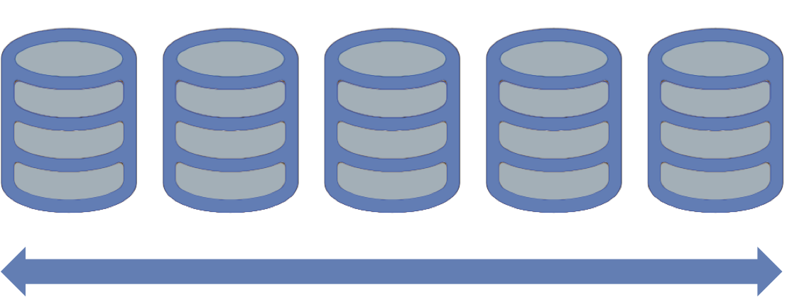
Horizontally Scalable
Notes:
Uses commodity hardware.
As more * is needed, add new shards.

Slide 9
Application Independent
Notes:
Every application can decide to use its databases/collections in a sharded/non-sharded way.
Only enable sharding on collections that need it.
NOT one size fits all.

Slide 10
One API
Notes:
Talking to a sharded system is the same as talking to a non-sharded system.

Slide 11
What is a Shard?

Slide 12
Replica Set
Primary
Secondary
Secondary

Slide 13
Single Node in a Cluster
Shard
Shard
Shard
P
S
P
S
P
S
S
S
S

Slide 14
Composed of Chunks
Grouping of data based on a range
Default Max Size: 64 MB

Slide 15
Chunks Have Ranges
A-B
S-Z
M

Slide 16
Chunks Get Split
A-B
S-V
M
W-Z

Slide 17
Chunks Get Migrated
One shard has 7 more chunks than another
Triggered manually

Slide 18
Chunks Get Migrated
One shard has 7 more chunks than another
Triggered manually

Slide 19
Chunks Get Migrated
One shard has 7 more chunks than another
Triggered manually

Slide 20
How does it all work?

Slide 21
Configuration
3 Config Servers
Just mongod
Stores chunk ranges and location
Not a replica set
Config
Config
Config

Slide 22
Routers
Mongos
Both a router and a balancer
No local data
Can have 1 or many
Mongos

Slide 23
Cluster
Application
Application
Mongos
Mongos
Config
Config
Config
Shard
Shard
Shard
P
S
P
S
P
S
S
S
S

Slide 24
Query Routing

Slide 25
Shard Key
Defines the range of data called a Key Space
Defines the distribution of documents in a collection
Every document must contain the Shard Key
Shard Keys are immutable

Slide 26
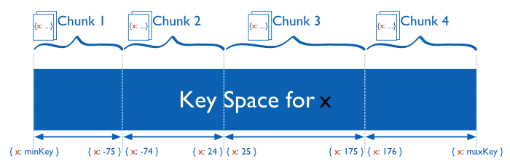
Chunks
Each chunk contains a non-overlapping range of Shard Key values
Notes:
Speak of the danger that can occur if the cardinality of a shard key is too low.
Speak also of the danger that can occur if a shard key is always increasing.

Slide 27
3 Types of Queries
Targeted Queries
Scatter Gather Queries
Scatter Gather Queries with Sorting

Slide 28
Targeted Queries
Query contains the shard key
Mongos
P
S
P
S
P
S
S
S
S

Slide 29
Scatter Gather Queries
Query does not contain the shard key
Mongos
P
S
P
S
P
S
S
S
S

Slide 30
Scatter Gather Queries with Sort
Query does not contain the shard key
Sorting is done first on the Shard
Results are merged in Mongos
Mongos
P
S
P
S
P
S
S
S
S

Slide 31
How do I pick a good Shard Key?

Slide 32
Considerations
Cardinality
Write Distribution
Query Isolation
Reliability
Index Locality
Notes:
Cardinality – Can your data be broken down enough?
Query Isolation - query targeting to a specific shard
Reliability – shard outages
A good shard key can:
Optimize routing
Minimize (unnecessary) traffic
Allow best scaling

Slide 33
Example: Email Storage
> db.emails.find({ user: 123 })
{
_id: ObjectId(),
user: 123,
time: Date(),
subject: “...”,
recipients: [],
body: “...”,
attachments: []
}

Slide 34
Example: Email Storage
 | Cardinality | Write Scaling | Query Isolation | Reliability | Index Locality
Notes:
Reliability = if we lost an entire shard what would be the effect on the system?
For most frequently used/largest indexes, how are they partitioned across shards?

Slide 35
Example: Email Storage
 | Cardinality | Write Scaling | Query Isolation | Reliability | Index Locality
_id | Doc level | One shard | Scatter/gather | All users affected | Good
Notes:
Reliability = if we lost an entire shard what would be the effect on the system?
For most frequently used/largest indexes, how are they partitioned across shards?

Slide 36
Example: Email Storage
 | Cardinality | Write Scaling | Query Isolation | Reliability | Index Locality
_id | Doc level | One shard | Scatter/gather | All users affected | Good
hash(_id) | Hash level | All Shards | Scatter/gather | All users affected | Poor
Notes:
Reliability = if we lost an entire shard what would be the effect on the system?
For most frequently used/largest indexes, how are they partitioned across shards?

Slide 37
Example: Email Storage
 | Cardinality | Write Scaling | Query Isolation | Reliability | Index Locality
_id | Doc level | One shard | Scatter/gather | All users affected | Good
hash(_id) | Hash level | All Shards | Scatter/gather | All users affected | Poor
user | Many docs | All Shards | Targeted | Some users affected | Good
Notes:
Reliability = if we lost an entire shard what would be the effect on the system?
For most frequently used/largest indexes, how are they partitioned across shards?

Slide 38
Example: Email Storage
 | Cardinality | Write Scaling | Query Isolation | Reliability | Index Locality
_id | Doc level | One shard | Scatter/gather | All users affected | Good
hash(_id) | Hash level | All Shards | Scatter/gather | All users affected | Poor
user | Many docs | All Shards | Targeted | Some users affected | Good
user, time | Doc level | All Shards | Targeted | Some users affected | Good
Notes:
Compound shard key, utilize already existing (used) index, partition chunk for "power" users.
For those users more than one shard *may* need to be queried in a targeted query.
Reliability = if we lost an entire shard what would be the effect on the system?
For most frequently used/largest indexes, how are they partitioned across shards?

Slide 39
How do I get up and running?

Slide 40
5 Steps
Launch Config Servers
Launch Mongos
Launch Shards
Add Shards
Enable Sharding

Slide 41
Launch Config Servers
mongod –configsvr
Starts 1 config server on the default port 27019
Config
Config
Config

Slide 42
Launch Mongos
mongos –configdb hostname:27019,hostname2:27019,hostname3:27019
Config
Mongos
Config
Config

Slide 43
Launch Shards
Nothing special, just like a normal replica set
Config
Mongos
Config
Shard
P
S
Config
S

Slide 44
Add Shards
Connect to mongos via the shell
sh.addShard(“<rsname>/<seedlist>”)
Config
Mongos
Config
Shard
P
S
Config
S

Slide 45
Verify that the shard was added
db.runCommand({ listShards: 1 }) {
shards : [
{ _id: “shard0000”, host: “<hostname>:27017” }
],
“ok” : 1 }

Slide 46
Enable Sharding
Enable sharding on a database
sh.enableSharding(“<dbname>”)
Shard a collection with the given key
sh.shardCollection(“<dbname>.people”, { country: 1 })
sh.shardCollection(“<dbname>”.cars”, { year: 1, uniqueid: 1})

Slide 47
Tag Aware Sharding
Tag aware sharding allows you to control the distribution of your data
Tag a range of shard keys
sh.addTagRange(<collection>,<min>,<max>,<tag>)
Tag a shard
sh.addShardTag(<shard>,<tag>)
Notes:
This can be skipped for the intro talk, but might be good to include if you’re doing the combined sharding talk. Totally optional, you don’t really have enough time to do this topic justice but it might be worth a mention.

Slide 48
Conclusion

Slide 49
Read/Write Throughput
Exceeds I/O
Notes:
Are you burning up your hard drives?
Are your TCP buffers full?
Is the network saturated?

Slide 50
Working Set
Exceeds Physical Memory
Notes:
Is there more data used on a regular basis than fits into memory.

Slide 51
Sharding Enables Scale
MongoDB’s Auto-Sharding
Easy to Configure
Consistent Interface
Free and Open Source

Slide 52
Thank You
#MongoDBDays
Craig Wilson
Software Engineer, MongoDB
@craiggwilson

